Slide 1
Object Oriented program Testing

Slide 2
Object-Oriented Testing
New Challenges
Software is composed of classes of objects and has unique features not found in other programming paradigms
Execution order is not necessarily predefined
Inheritance, polymorphism, overloading, message passing, association, aggregation…
Information-hiding features of object-oriented paradigm

Slide 3
Algebraic Specifications
Use algebraic specification to formally specify object-oriented program
Two parts: syntax declaration and semantic specification
  Syntax declaration lists the operations, their domains and codomains, input and output
  Semantic specification consists of equational axioms, that describe the behavioral properties of the operations

Slide 4
Module INTSTACK
classes Int, Bool, IntStack
operations
new : → IntStack
_.empty : IntStack → Bool
_.push(_) : IntStack, Int → IntStack
_.pop : IntStack → IntStack
_.top : IntStack → Int ∪ {NIL}
variables
S : IntStack
N : Int
axioms
a₁ : new.empty = true
a₂ : S.push(N).empty = false
a₃ : new.pop = new
a₄ : S.push(N).pop = S
a₅ : S.top = NIL if S.empty
a₆ : S.push(N).top = N

Slide 5
Term and normal forms
A term is a series of operations in an algebraic specification.
  new.push(1).push(2).pop
A term is in normal form iff it cannot be further transformed by any axiom.
  new.push(1).push(2) ✓
  new.push(1).push(2).pop ✗

Slide 6
Equivalent terms, ground terms
Two terms are said to be equivalent if and only if they can both be transformed to the same normal form.
  new.push(1).push(2).pop
  new.push(3).pop.push(1)
  Equivalent, because both can be transformed to the normal form new.push(1)
A term without variables is called a ground term

Slide 7
Pairs of equivalent terms
Let u₁ and u₂ be two terms and s₁ and s₂ be their corresponding method sequences in a given implementation. Then test case {u₁,u₂} reveals an error if u₁ is equivalent to u₂, but s₁ and s₂ produce observationally different objects.

Slide 8
Conventional approach versus pairs of equivalent terms
The conventional approach of testing the output B of operation _.op using input A is just a special case of equivalent terms: the equivalent terms are A.op and B

Slide 9
Detecting errors?
If an error occurs in a common subterm of a pair of equivalent terms, it cannot be revealed with this pair as test case.
  u₁ = new.push(1).push(2).pop
  u₂ = new.push(1)
  if _.push(1) is implemented as _.push(11), it cannot be detected using u₁ and u₂. But can by another pair: new.push(1).top and 1.

Slide 10
Fundamental pairs
In general for given specification, the set of all ground terms is infinite.
Select a finite representative subset instead.

Slide 11
Fundamental pairs
A pair of equivalent ground terms, formed by replacing all the variables of an axiom by normal forms, is called a fundamental pair of equivalent terms induced by the axiom.
  new.push(1).push(3).pop ≈ a₄
  new.push(1) ✓
  new.push(1).push(2).pop.push(3).pop ≈
  new.push(1) ✗

Slide 12
Selecting test set
Test only fundamental pairs
Still can be infinite, exhaustive testing is impossible.
  Axioms may contain branch conditions
  May have infinite number of normal forms to use with axioms
Use algorithm GFT for Generating a Finite number of Test cases!

Slide 13
Path-based domain partition (PDP) for particular method m
Partition the input domain of m into subdomains such that all test points in each subdomain cause a particular path to be executed (white-box)
Use the simplified domain-testing strategy to select some test points, if can
Otherwise, select randomly a point from each subdomain.

Slide 14
Algorithm GFT
Take n axioms a₁, a₂, … a_{n}
For a variable in axiom a_{i}, create all normal forms of length no greater than k, obtain a_{ij}
Check all operations f within the obtained equations, and using conditions to define f, partition the input domain of f into subdomains.
Randomly select an element from each subdomain
If f is implemented by method m_{f} apply PDP for selecting another group of fundamental pairs.

Slide 15
Example
Suppose we have a stack object implemented with array of 100 elements, that has overflow error. Then
  new.push(1).push(2)…push(100).push(101).pop
  new.push(1).push(2)…push(100)
will reveal the error. However, if k=10 for variable S in axiom a₄, error cannot be found.

Slide 16
Points about GFT
We assume that specification, axioms and complete implementation is given.
It is difficult to determine the positive k in step 1.
  Can apply a white-box technique
  The size of test-suite can be O(m^{k}), where m is the number of constructors.

Slide 17
Object equivalence
After executing a fundamental pair u₁ and u₂, we get two resulting objects O₁ and O₂
Observationally equivalent objects may contain variables with different values
  May contain variables that are not important in the given object state
  May contain variable invariants

Slide 18
Variable invariant
class SillyClass {
public int x;
public int SillyOp(int i) {
return (i+x) % 6;
}}
A = SillyClass.create();
A.x = 4;
B = SillyClass.create();
B.x = 10;

Slide 19
Black-box undecidability
The observational equivalence problem is undecidable using black-box techniques.
In other words, there exists objects that are not observationally equivalent, but appear to be such when only a finite number of methods are applied to them.

Slide 20
Relevant Observable Context
Idea is following: if two objects O₁ and O₂ has different values of data member d, then the sequence of methods that reveal this difference is called a relevant observable context.
Only these method sequences are relevant and should be considered.

Slide 21
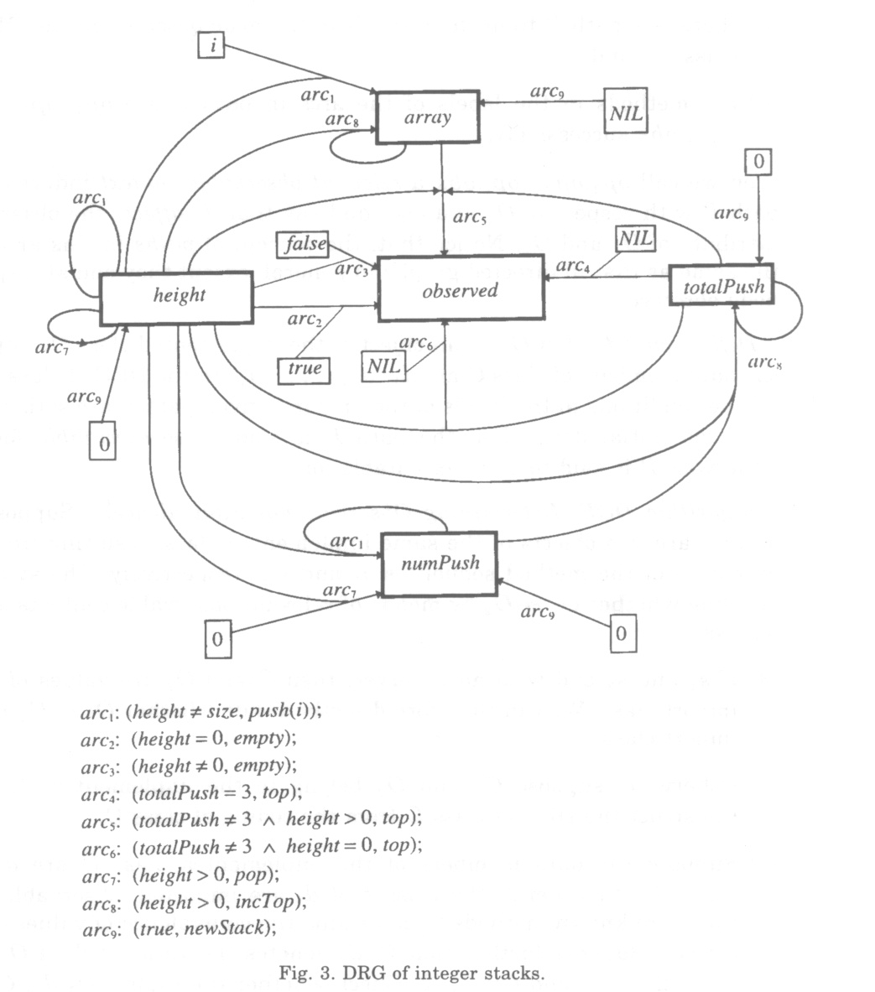
Data member relevance graph (DRG)

Slide 22
Algorithm DOE
(Determining Observational Equivalence)
Input – objects O₁ and O₂ of class C
Construct DGR of class C from code
If all data members has equal values, then O₁ ≈ O₂
If not, for each d_{i} that is different check if it has a path to observable variable. If yes, then…

Slide 24
..continue..
Traverse each acyclic executable path P to an observable variable once and obtain relevant observable context induced from P
  If there are uninstantiated variables in context, apply PDP to select values
If cycle is encountered, the user should manually decide on number of iterations

Slide 25
Limitations
Infinite cycles, which leads to infinite number of relevant observable contexts
Fault masking. What if the relevant observable context sequence itself contains an error?
The size of DRG graph can be big

Slide 26
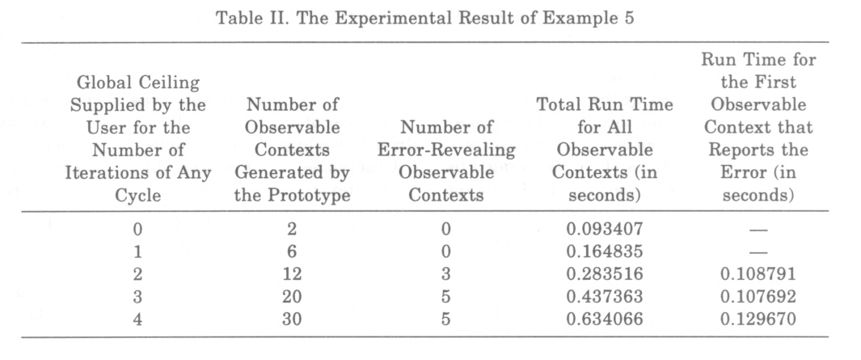
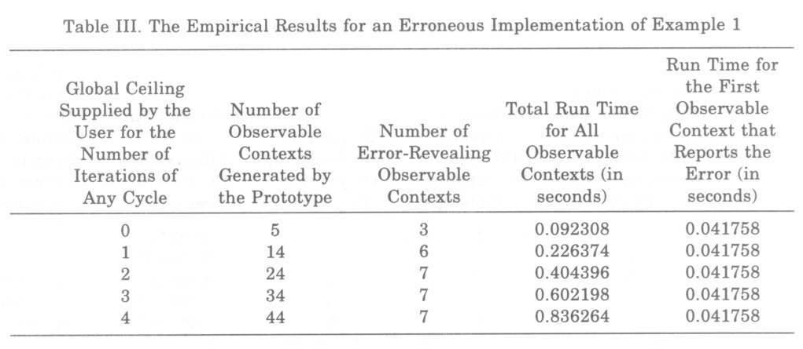
Experimental results

Slide 27
Future work
The investigation of nonequivalent terms as test cases
Testing inheritance among groups of cooperating classes
Heuristic approach to find the constants k and t required for algorithms

